Slide 1
Greater Peoria Mass Transit District DBE Event May 26, 2022

Slide 2
Who is Eligible?
Applicant firms must be found eligible to be certified as a DBE under the federal regulations contained in 49 CFR Part 26.
Eligibility standards include that the firm must be at least 51% owned and controlled by one or more socially and economically disadvantaged individuals.
The firm must be controlled and managed on a daily basis by the disadvantaged owner(s).

Slide 3
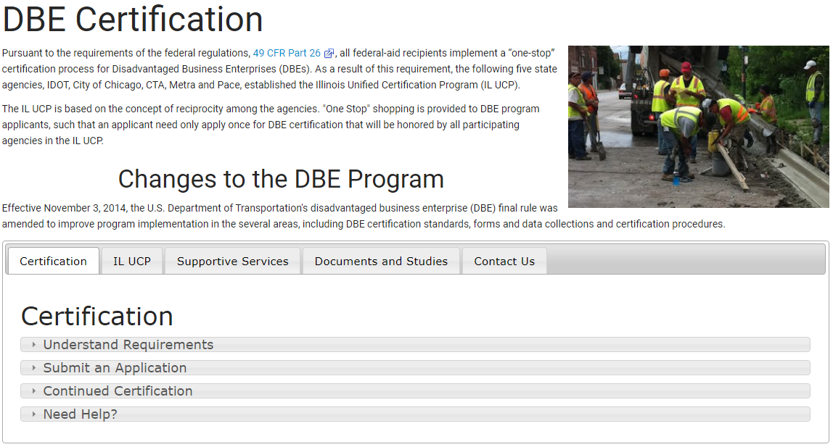
How to Register
Go to IDOT’s webpage to submit an application
https://idot.illinois.gov/doing-business/certifications/disadvantaged-business-enterprise-certification/index
IDOT’s DBE Certification Section: (217) 782-5490

Slide 4
GPMTD DBE Goals
STATE FUNDED PROJECTS
Each project supported by State funds are assigned a unique DBE Goal provided by IDOT’s DBE EEO Labor Compliance Manager
FEDERALLY FUNDED PROJECTS
GPMTD has developed a 9% overall DBE goal applicable to Fiscal Years 2021-2023 for projects supported by Federal funds

Slide 5
Federal DBE Goal Setting Methodology
Two-Step Process
STEP 1 | Step 2
Develop base figure for relative availability of DBE’s | Adjust base figure

Slide 6
Step 1: Develop a Base Figure
Part A
Determine Market Area
State of Illinois
Determine FTA-assisted Projects
Assign those projects NAICS codes
North American Industry Classification System
A weighted figure is then calculated for each project.

Slide 7
Step 1: Develop a Base Figure
Part B
Determine the Relative Availability of DBE’s by NAICS Code
# of RWA DBE’s within GPMTD Market Area
IDOT’s IL UCP Directory
# of All Firms Available within GPMTD Market Area
Data.census.gov
RWA DBE’s / All RWA Firms = Relative Availability
2034 / 32,232 = 6.31%

Slide 8
Step 1: Develop a Base Figure
Part C
Determine a Weighted Base Figure
(Weighted Figure) x (Relative Availability) = Base Figure
Or
Part A x Part B

Slide 9
Step 1: Develop a Base Figure
 | A | B | C | D | E | F | G
Component | NAICS Code | Description of Contract Anticipated for award | # DBE Available (IL UCP Directory) | # Firms Available (data.census.gov) | Relative Availability =C/D | Weight (% of Total Grant Funds) | Weighted Base (=E*F)
A | 238910 | Demolition Contractor | 126 | 1127 | 11.18% | 18.75% | 2.10%
 | 237310 | Concrete Paving | 291 | 386 | 75.39% | 1.91% | 1.44%
 | 561730 | Landscaping Services | 112 | 4679 | 2.39% | 0.29% | 0.01%
 | 221122 | Electric Power Distribution | 1 | 203 | 0.49% | 1.99% | 0.01%
 | 236220 | General Contractor | 129 | 1384 | 9.32% | 1.65% | 0.15%
 | 238110 | Concrete Construction | 154 | 795 | 19.37% | 14.71% | 2.85%
 | 238140 | Masonry Contractors | 40 | 892 | 4.48% | 1.24% | 0.06%
 | 238130 | Framing Contractors | 48 | 392 | 12.24% | 8.75% | 1.07%
 | 238350 | Carpentry Work | 81 | 1376 | 5.89% | 1.47% | 0.09%
 | 238170 | Metal Siding installation | 9 | 439 | 2.05% | 7.21% | 0.15%
 | 238160 | Roof Membrane Installation | 19 | 883 | 2.15% | 3.05% | 0.07%
 | 238290 | Overhead Door Installation | 26 | 320 | 8.13% | 5.11% | 0.42%
 | 238310 | Drywall Contractor | 51 | 564 | 9.04% | 0.30% | 0.03%
 | 238320 | Painting Contractor | 111 | 1524 | 7.28% | 0.53% | 0.04%
 | 327110 | Bathroom Accessories | 0 | 23 | 0.00% | 0.05% | 0.00%
 | 332321 | Doors | 6 | 32 | 18.75% | 0.03% | 0.01%
 | 423990 | Fire Extinguishers | 24 | 402 | 5.97% | 0.05% | 0.00%
 | 238220 | Plumbing, HVac and Fire Suppression | 61 | 4084 | 1.49% | 25.68% | 0.38%
 | 238210 | Electrical Contractors | 87 | 2722 | 3.20% | 7.21% | 0.23%
 | 238990 | Sign Erection | 108 | 1489 | 7.25% | 0.02% | 0.00%
 | A | B | C | D | E | F | G
Component | NAICS Code | Description of Contract Anticipated for award | # DBE Available (IL UCP Directory) | # Firms Available (data.census.gov) | Relative Availability =C/D | Weight (% of Total Grant Funds) | Weighted Base (=E*F)
B | 238160 | Roofing Contractors | 19 | 883 | 2.15% | 41.67% | 0.90%
 | 423330 | Roofing Materials wholesalers | 2 | 143 | 1.40% | 58.33% | 0.82%
C | 236220 | Commercial Industrial Building Construction | 129 | 1387 | 9.32% | 28.55% | 2.66%
 | 423610 | Electrical Supplies wholesalers | 46 | 570 | 8.07% | 30.37% | 2.45%
 | 541310 | Architectural Design Services | 56 | 964 | 5.81% | 9.19% | 0.53%
 | 541330 | Civil Engineering Services | 211 | 1850 | 11.41% | 15.77% | 1.80%
 | 238210 | Electrical Contractors | 87 | 2722 | 3.20% | 16.13% | 0.52%
Rounded, Weighted Base Figure |  |  |  |  |  |  | 9.00%

Slide 10
Step 2: Adjust Base Figure
Examine all evidence available in our jurisdiction to determine in an adjustment to the base figure is needed.
If the evidence does not suggest an adjustment is necessary, then an adjustment is not required.

Slide 11
Step 2: Adjust Base Figure
(cont . . .)
Past participation
Evidence from disparity studies
Statistical disparities relating to financing, bonding and insurance
Data on employment, self-employment education and training, and union apprenticeship programs
Other data at your discretion

Slide 12
TIP Information
GPMTD is required, under 49 U.S.C. 5303(j) , to develop a Transportation Improvement Program (TIP) – a list of upcoming transportation projects – covering a period of at least four years.
The TIP must be developed in cooperation with the state and public transit providers.
The TIP should include capital and non-capital surface transportation projects, bicycle and pedestrian facilities and other transportation enhancements, Federal Lands Highway projects, and safety projects included in the State’s Strategic Highway Safety Plan.

Slide 13
Upcoming Projects
GPMTD is required, under 49 U.S.C. 5303(j) , to develop a Transportation Improvement Program (TIP) – a list of upcoming transportation projects – covering a period of at least four years.
The TIP must be developed in cooperation with the state and public transit providers.
The TIP should include capital and non-capital surface transportation projects, bicycle and pedestrian facilities and other transportation enhancements, Federal Lands Highway projects, and safety projects included in the State’s Strategic Highway Safety Plan.
https://tricountyrpc.org/documents/transportation-improvement-program/

Slide 14
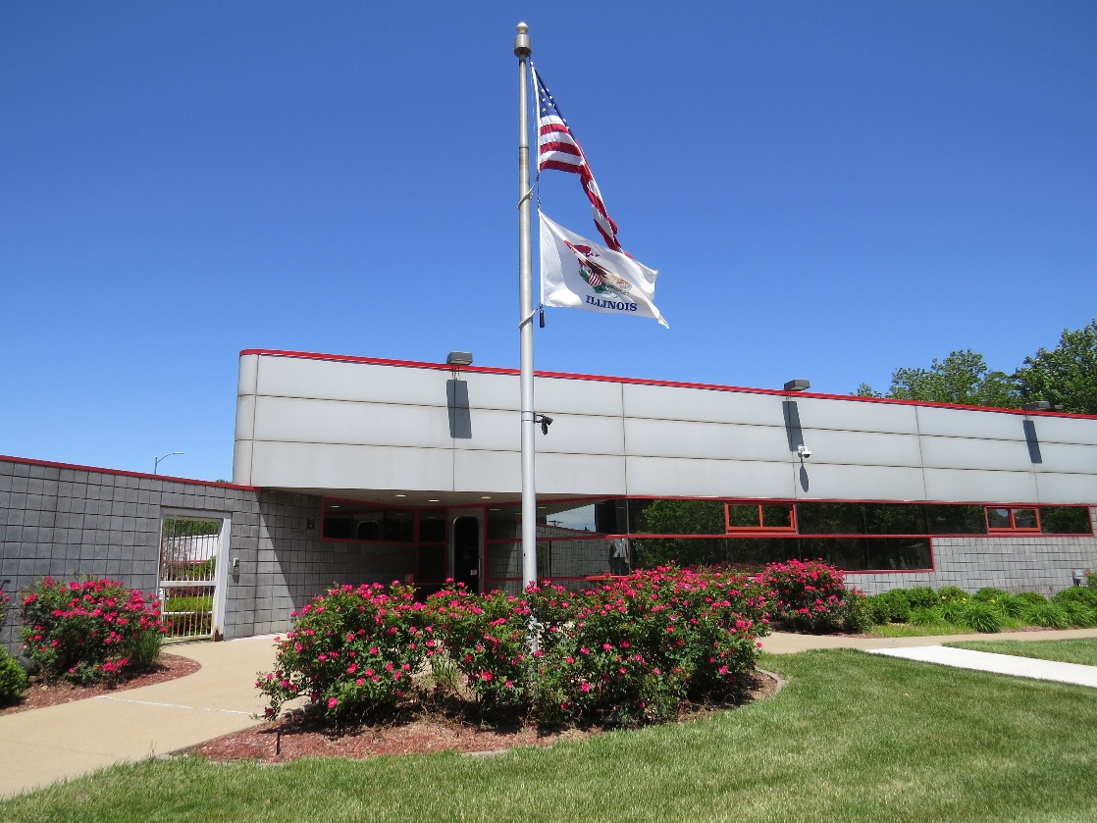
Admin Building Roof Replacement
FY 2023
Estimated Total Cost - $300,000

Slide 15
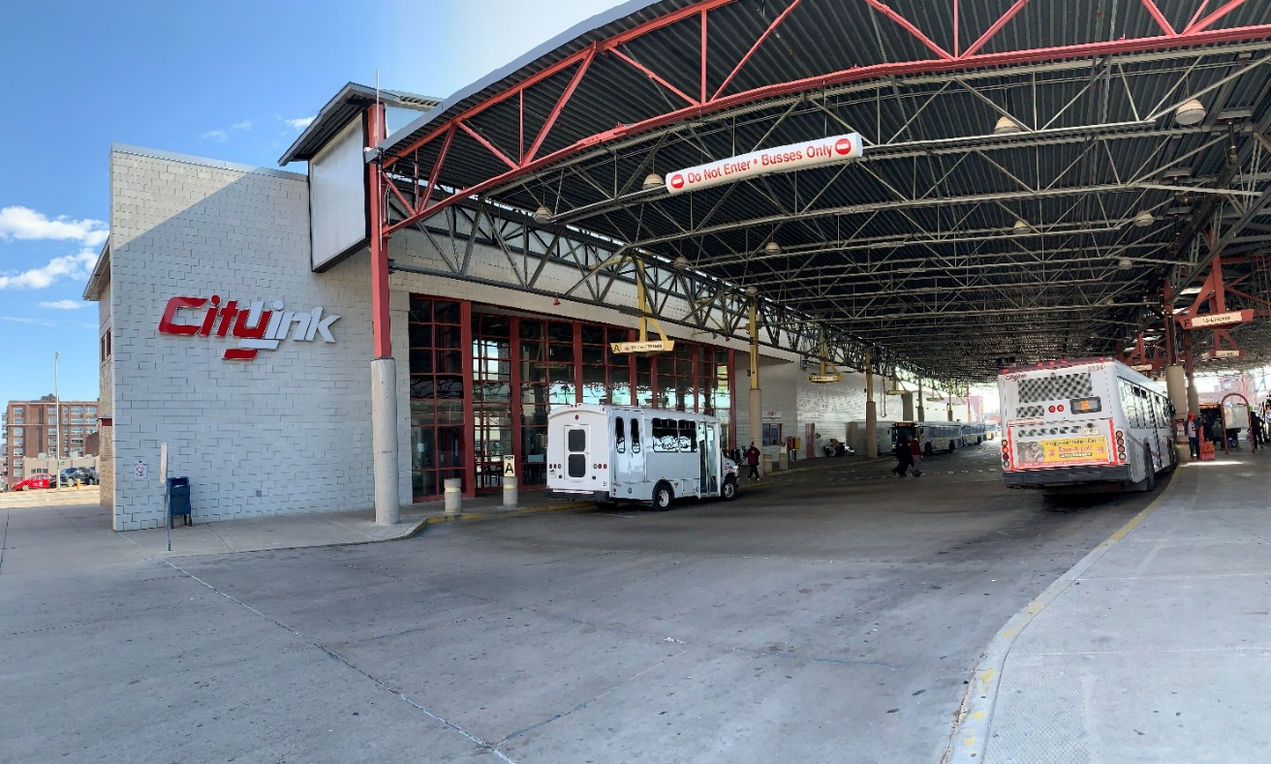
Transit Center Outdoor Rehabilitation
FY 2023
New benches, overhead signs, new curbing, concrete painting and cleaning, wayfinding, kiosks & bike racks
Estimated Total Cost – $3 million

Slide 16
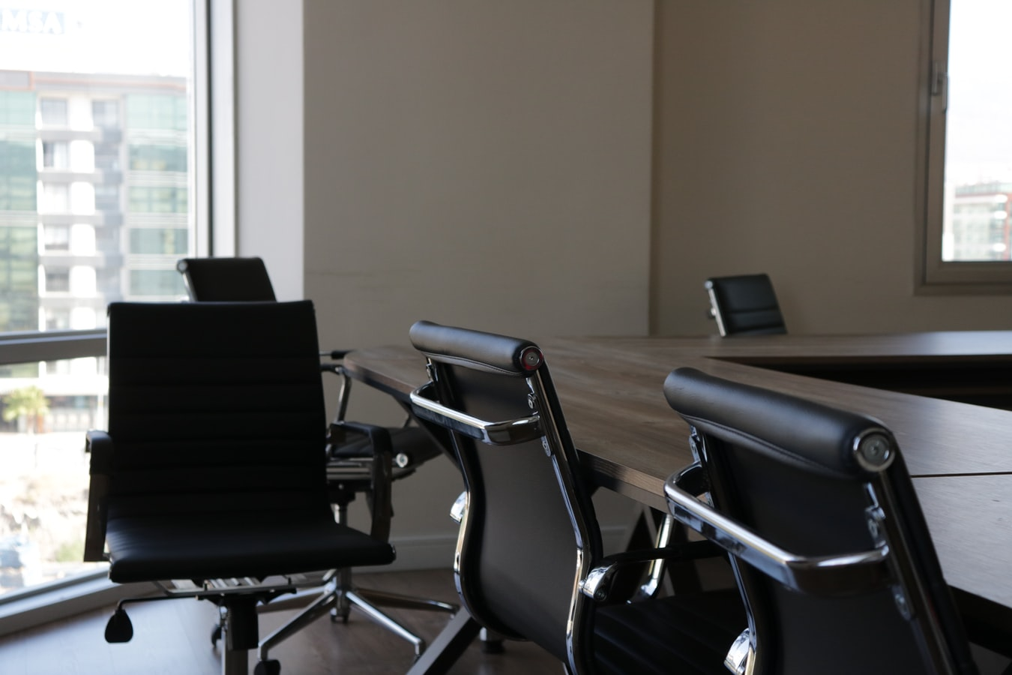
Office Furniture/Equipment
FY 2023
Estimated Total Cost - $600,000-$800,000

Slide 17
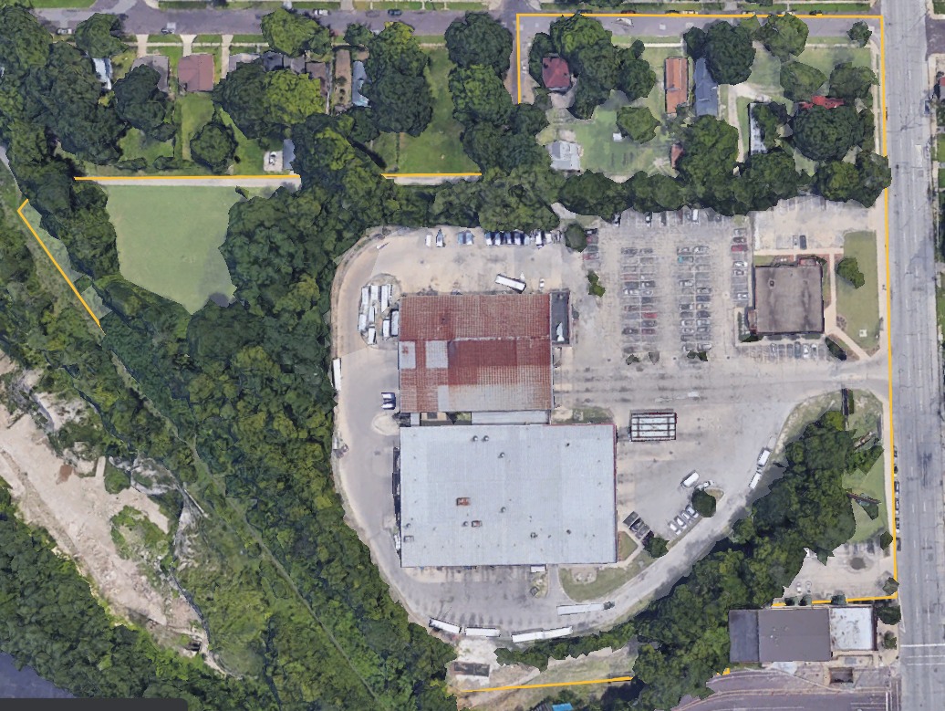
Demolition for Construction Project
FY 2023
Estimated Total Cost - $500,000

Slide 18
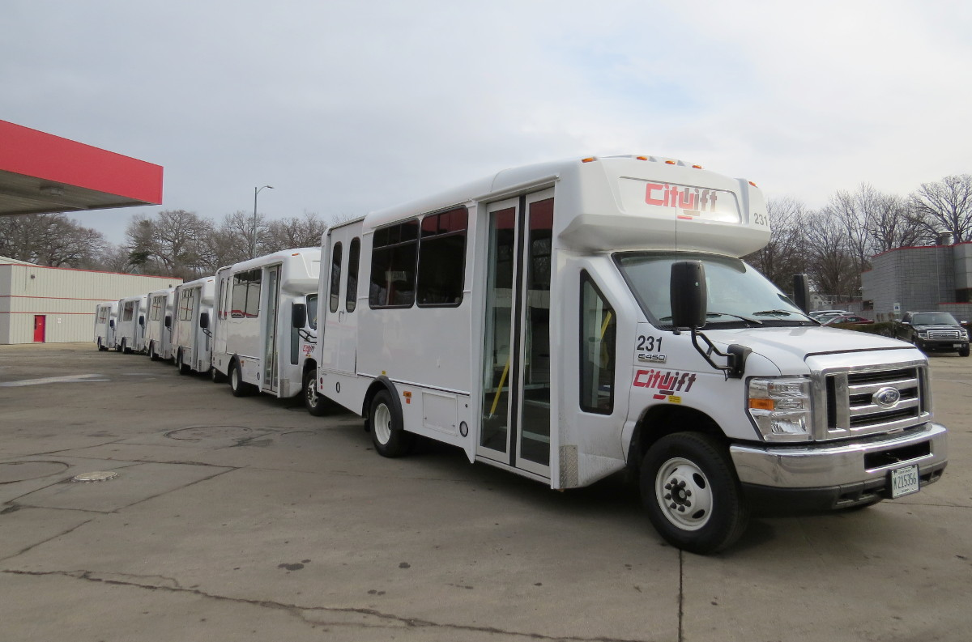
Paratransit Camera System
FY 2023
Estimated Total Cost - $450,000

Slide 19
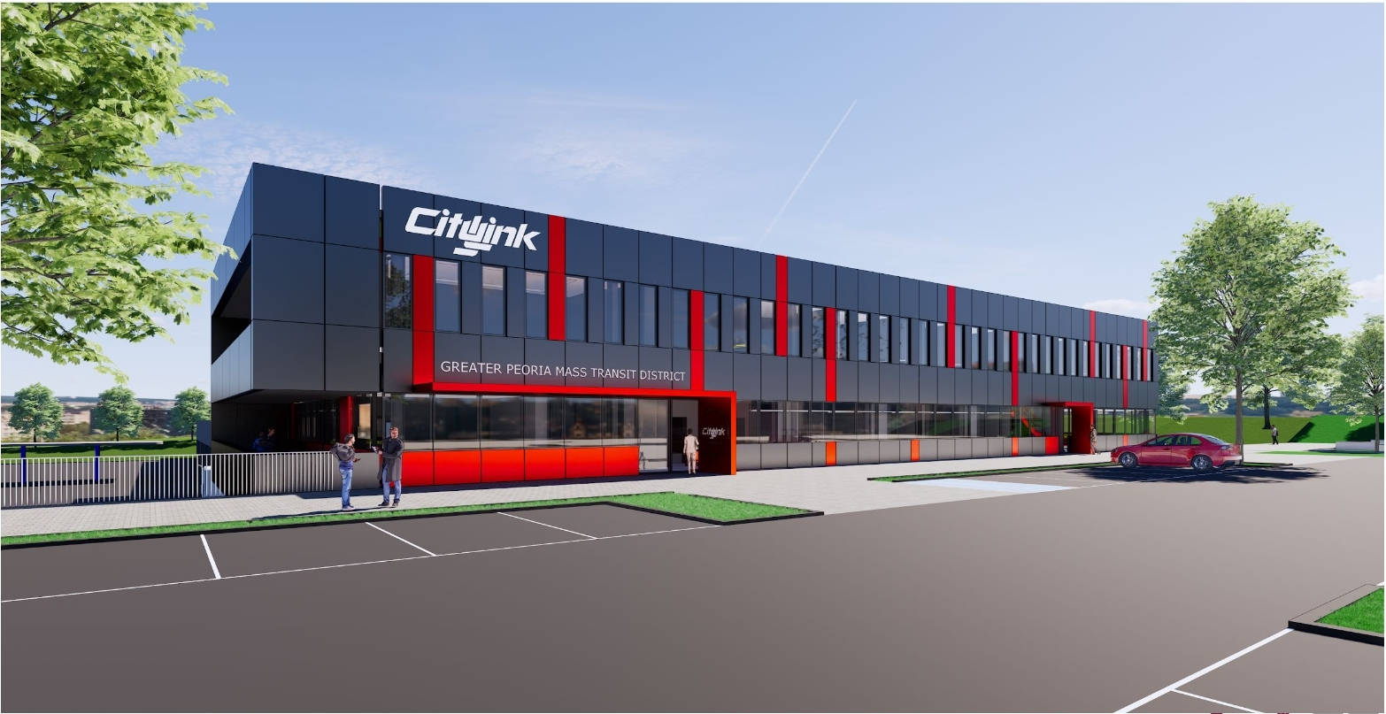
Maintenance & Admin Facility Construction
FY 2023
Solar array systems for the new building with an alternate for solar car port with electric vehicle chargers
Selective demo for 1992 building
Flooring for new building

Slide 20
Upcoming Service Agreements
FY 2023
Licensed Electrician Services
Licensed HVAC Technician Services
Licensed Plumbing Services

Slide 21
Potential Future Projects
Transit Center Daycare Center Remodel
Farebox Replacement/Smartphone App
Scooter/Bike Share Program
Microtransit Service

Slide 22
DBE Outreach Program
GPMTD will host a public outreach event on the last Thursday of every May. The invitation for this event will be sent directly to the 161 individuals listed as IDOT UCP in the appropriate NAICS codes. The event will be publicized in the legal section of the Peoria Journal Star, on GPMTD’s website, and GPMTD’s social media channels.
GPMTD will maintain all records of the event, including who was invited, attendees, and comments.

Slide 23
Soliciting Bids
Current projects are listed on GPMTD webpage
https://www.ridecitylink.org/resources/procurement/
Local projects are posted in PJStar
Transit Specific non-construction projects are posted on various sights such as:
https://www.transittalent.com/
All prime contractors are encouraged to subcontract with DBEs and other Small Businesses.
GPMTD requires all awarded contractors to submit a DBE Unavailable Certification to ensure they are making a good faith effort in obtaining DBE subcontracts.

Slide 24
What is new . . .
To encourage more DBE participation GPMTD is expanding its DBE Vendor list.
All projects with potential DBE opportunities will be reviewed by project type.
Interested DBE’s will be notified of the opportunity
Prime Contractors: Will have the opportunity to bid on the project
SubContractors: If they are interested in bidding as a subcontractor GPMTD will post a list of interested DBE’s on its website in order to ensure its Good Faith Effort requirement is being met.
DBE Registration Form will be available on GPMTD’s website

Slide 25
Contact Information
Nick Standefer, Assistant General Manager & DBE Liaison Officer
Phone: 309-679-8153
Email: nstandefer@ridecitylink.org
www.ridecitylink.org/resources/disadvantaged-business/

Slide 26
Questions and Comments?

